Slide 1
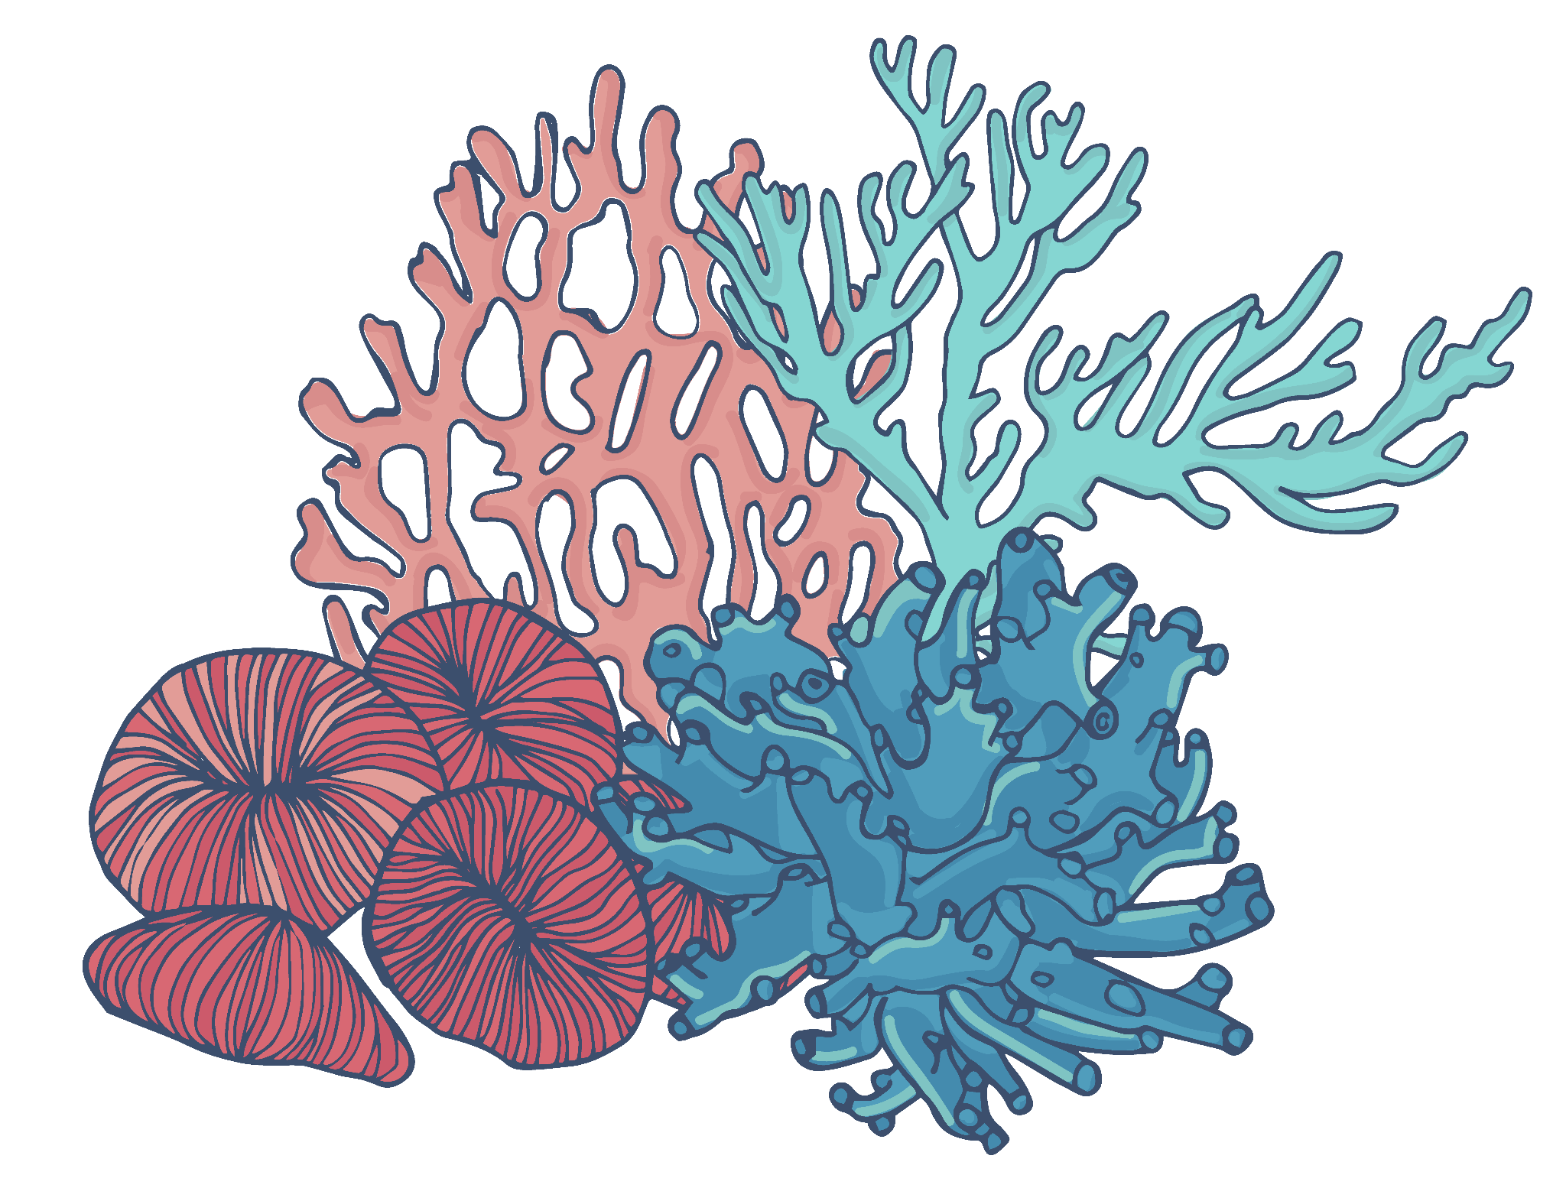


BIOL 5340 - BIOINFORMATICS FINAL PROJECT - GROUP 12 (OANN) ALGORITHM: Support Vector Machine
TEAM MEMBERS | UTA ID
Mahima Krishna Reddy Karna | 1002069435
Sakshi Nischal | 1002085832
Nikhil Das Karavatt | 1002085391
Pujith Vaddi | 1002032705
Hari Chandana | 1002084349

Slide 2
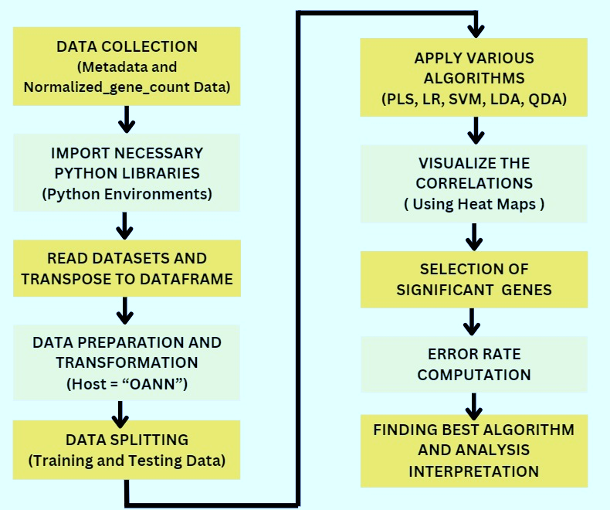
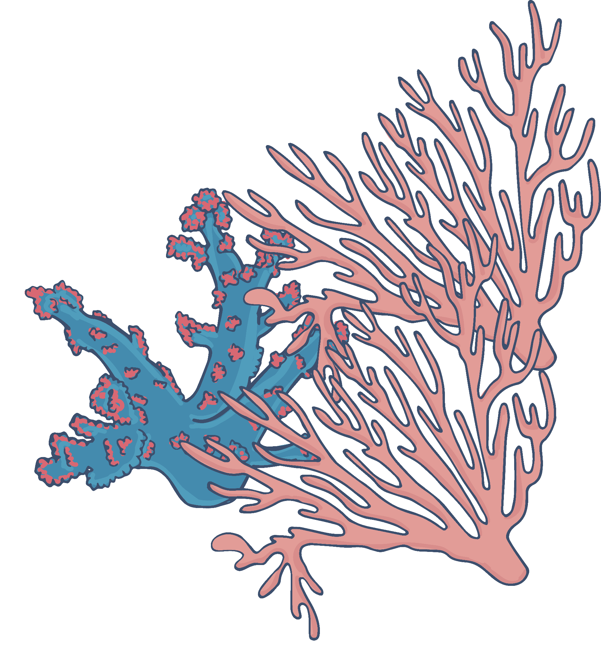

Flow Chart

Slide 3

Table of ML Algorithms Results
ML Algorithms | # Genes or Components Required/Obtain Significant Results | Error Rate
Logistic Regression | Number of Components : 20 | 0.1111
Linear Discriminant Analysis | Number of Components : 5 | 0.4444
Quadratic Discriminant Analysis | Number of Components : 20 | 0.2222
Support Vector Machines | Number of Components : 13 | 0.1111
Partial Least Squares | Number of Components : 7 | 0.1111

Slide 4
BEST ALGORITHM: Support Vector Machine
1. Uncharacterized UDP-Glucosyltransferase YdhE - Bacillus subtilis:
Function: While specific functions are not detailed, UDP-glucosyltransferases generally play roles in the modification of molecules by adding glucose units. This can be important in various biological processes including metabolism, detoxification, and cellular signaling.
Relevance to Cladacopium: Although the exact function in Bacillus subtilis is not characterized, the general role of glucosyltransferases in metabolism could be relevant. Metabolic processes are crucial in the symbiotic relationship between Cladacopium and its coral host, especially in terms of nutrient exchange and adaptation to environmental stressors.
2. Biotin/Lipoyl Attachment Protein - Bacillus subtilis:
Function: This protein is involved in the attachment of biotin or lipoic acid to enzymes that require these molecules as cofactors. Biotin and lipoic acid play important roles in critical metabolic pathways.
Relevance to Cladacopium: Enzymatic cofactors are vital for the functioning of many metabolic pathways. In the context of Cladacopium, understanding how essential cofactors are attached to enzymes can provide insights into the metabolic efficiency and adaptability of the symbiotic algae, especially under varying environmental conditions.
The SVM algorithm identified theproteins as significant, suggesting they might have distinctive roles or features within the dataset. This could indicate that the metabolic processes they are involved in are important in differentiating between certain biological states or conditions relevant to Cladacopium.

Slide 5
SUMMARY
Does the one algorithm describe this dataset the best?
The Support Vector Machine (SVM) algorithm appears to perform the best for this dataset. The SVM achieved a cross-validated accuracy of approximately 72.38% and a test set accuracy of 88.89%. These metrics, along with a detailed classification report, indicate that the SVM model effectively distinguishes between the classes in the dataset.
What can we infer about the dataset based on the algorithm that works the best?
The data's successful analysis with SVM suggests it contains patterns amenable to linear separation. The superior performance of the SVM suggests that the dataset's underlying structure is well-suited for a classification approach that identifies an optimal hyperplane to separate classes. The SVM's ability to handle high-dimensional spaces is particularly relevant in the context of gene expression data, where the number of features (genes) is often large. The accuracy and performance metrics indicate that the SVM successfully captures the patterns and relationships within the data, contributing to its effectiveness in classification.
What biologically meaningful information can we gather from the genes that are significant for classification?
while the direct relevance of these specific proteins from Bacillus subtilis to Cladacopium and its host might not be immediately clear, the metabolic processes they are involved in are fundamental and could provide valuable comparative insights into the metabolic aspects of the Cladacopium-host symbiosis. Further research specifically targeting Cladacopium and its host is required to establish more direct connections.

Slide 6

01

